Slide 1





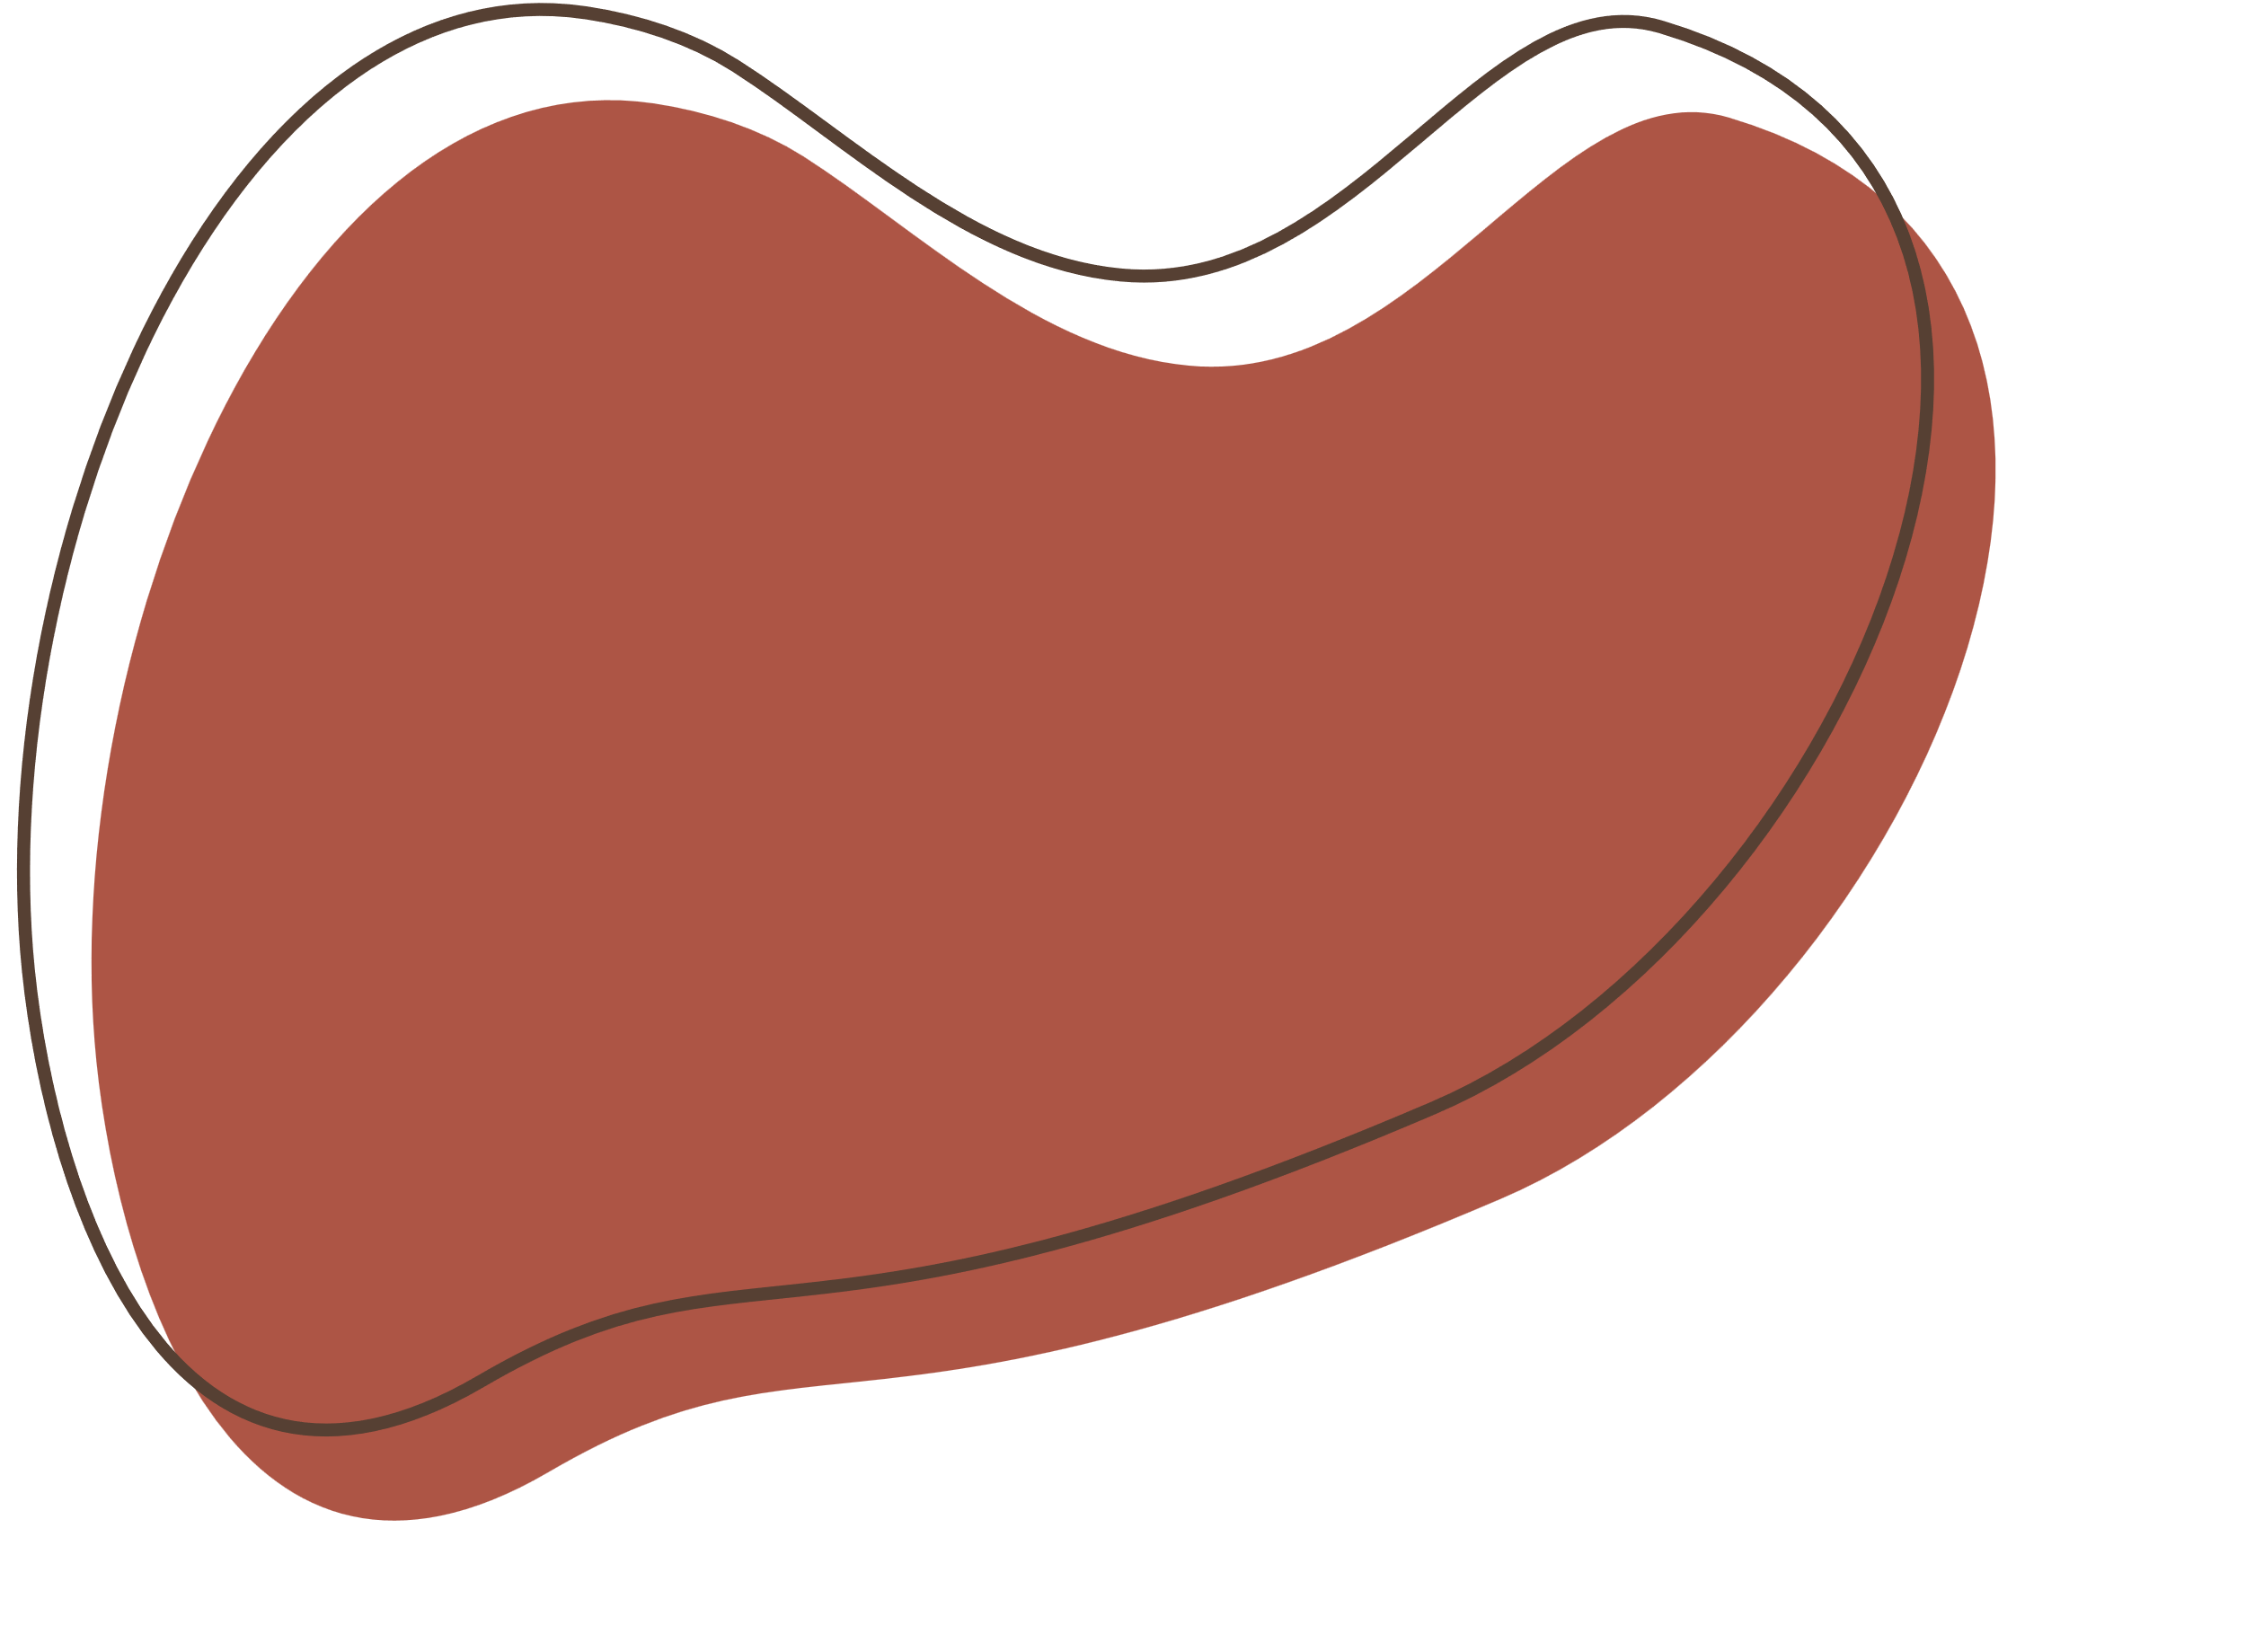
C.H.I.P The Fridge
Ana Jin 99176
Inês Pissarra 99236
Juliana Marcelino 99261
Notes:
ANA - Have you ever gone shopping and had doubts about the products you already had in the fridge?
INES - Did you end up buying repeated food?
JULIANA - Did repeated food end up spoiling?
JULIANA - CHIP the fridge is the solution!
JULIANA - CHIP is a smart fridge that tracks everything you have inside it. You just need to scan your product and put it in the fridge. CHIP will show you your products, some alerts and create a shopping list based on the fridge history.

Slide 2
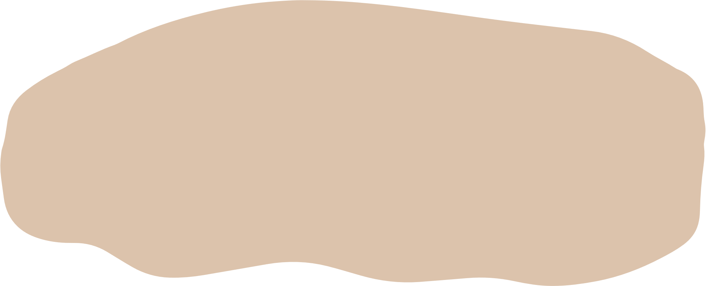
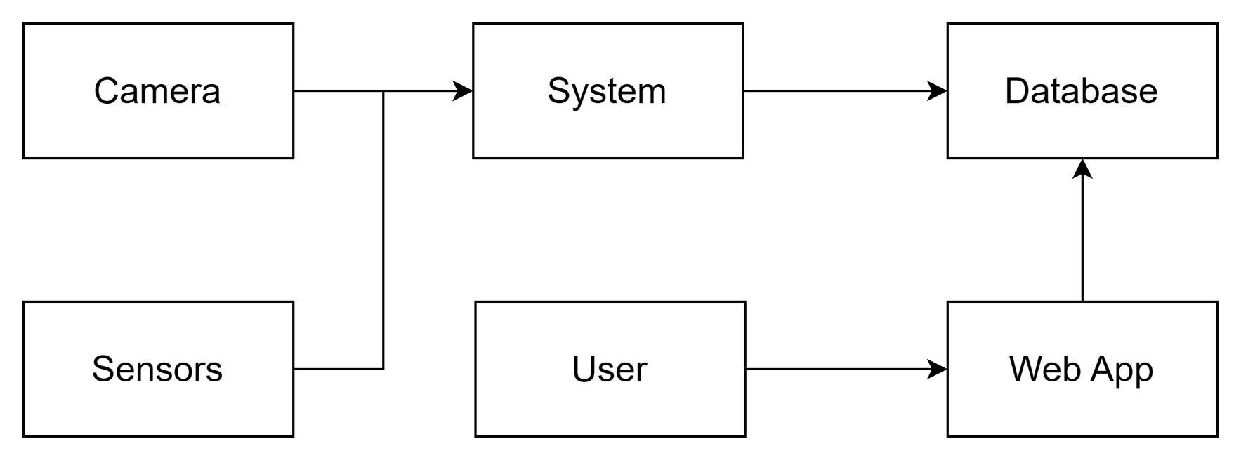
General Architecture
Notes:
INES - As we can see, CHIP has a very simple architecture. It has a central system that receives information from camera and sensors and stores the information in a database. Then, there is a web app that allows the user to check each products are in the fridge, their expiration date and the suggested shopping list. The user can also interact with the app to ask to send the shopping list by email.

Slide 3
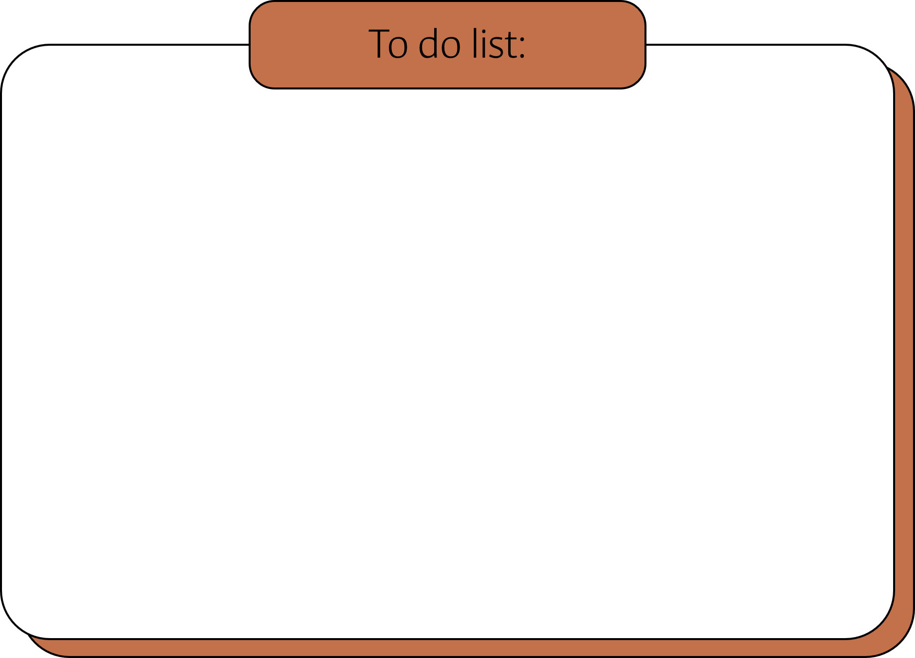
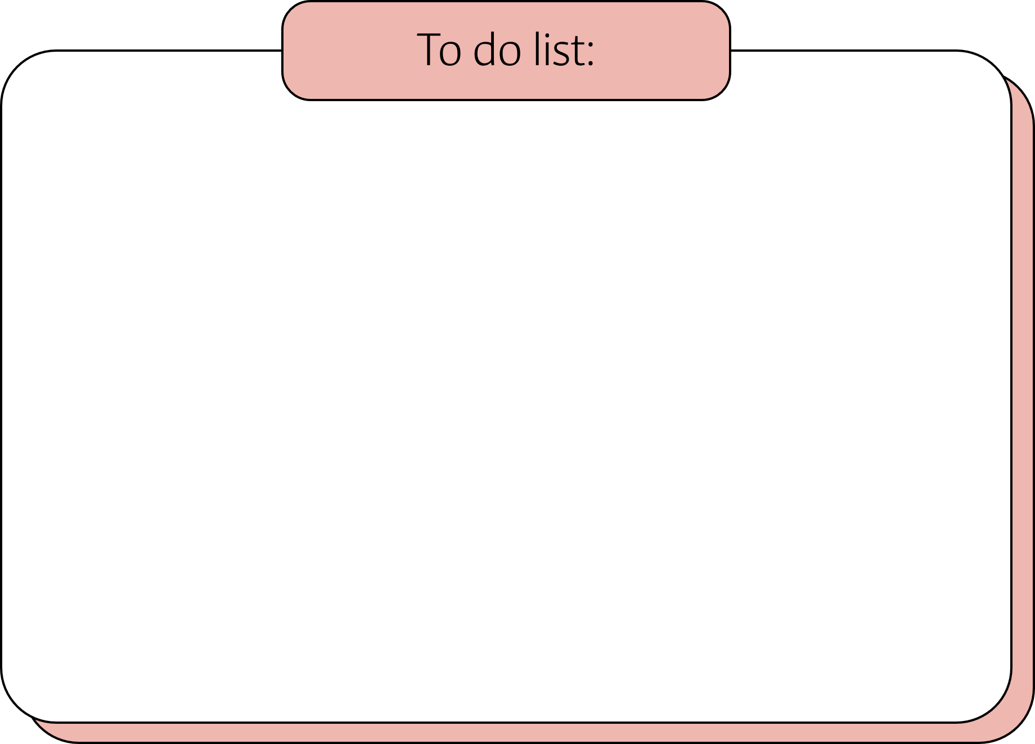
Materials
Hardware
Software
RectLabel
TensorFlow
PyTorch
Google Colab
OpenMV IDE
Arduino IDE
Visual Studio Code
Camera
Light Sensor
Arduino
Monitor
Notes:
ANA - RectLabel was used to create dataset to train our machine learning models, the next three were used to train the models, OpenMV IDE to program the camera, Arduino IDE to program the arduino to control the breadboard and lastly, VSCode for everything else.

Slide 4

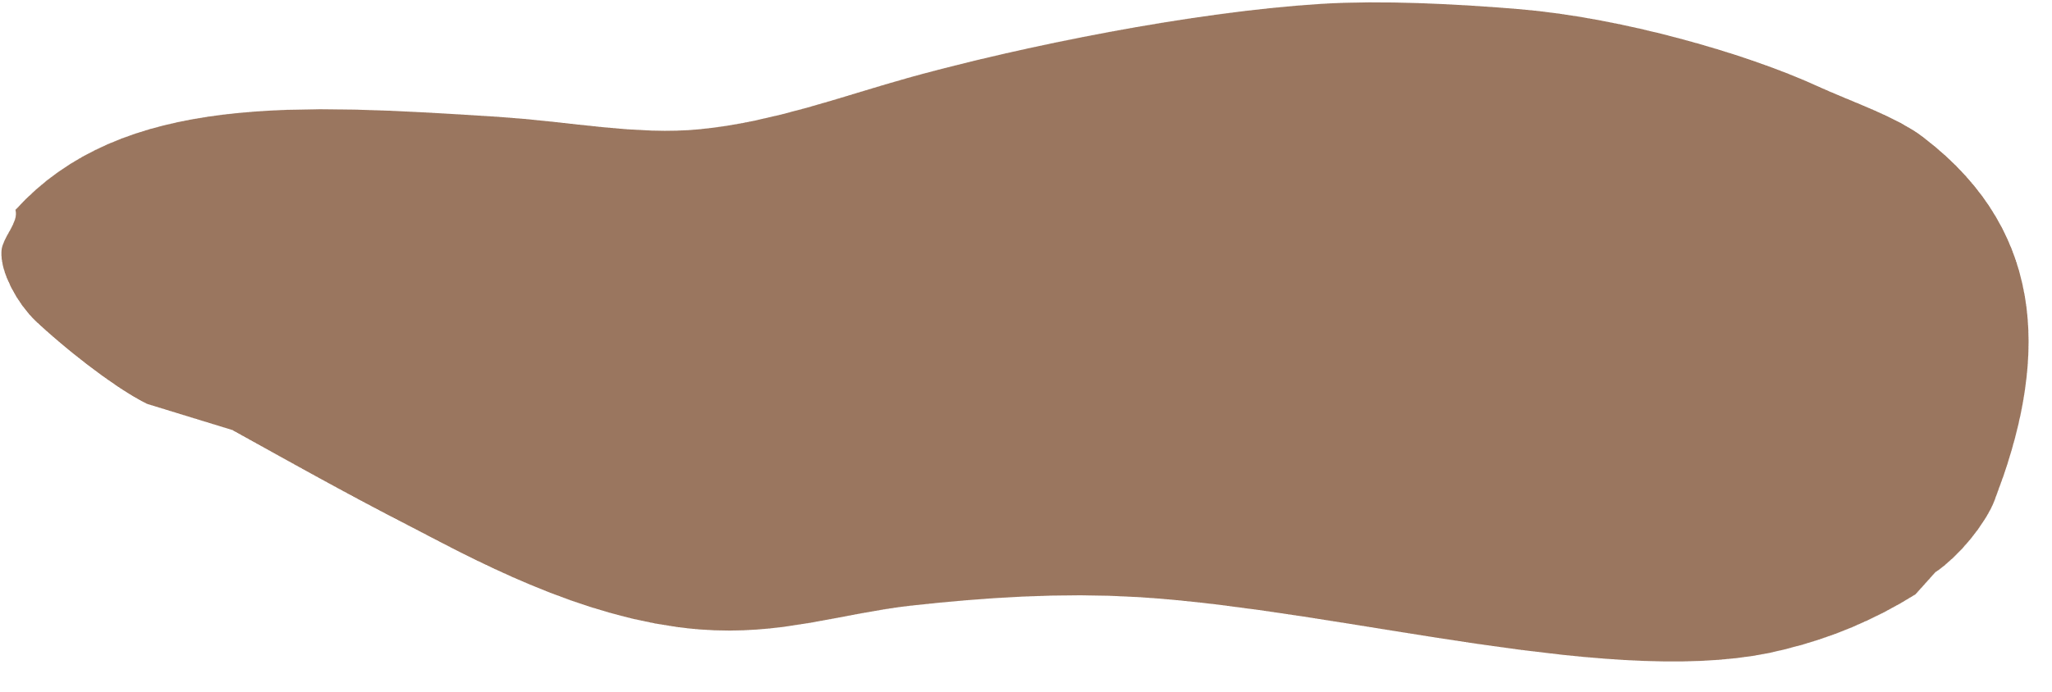

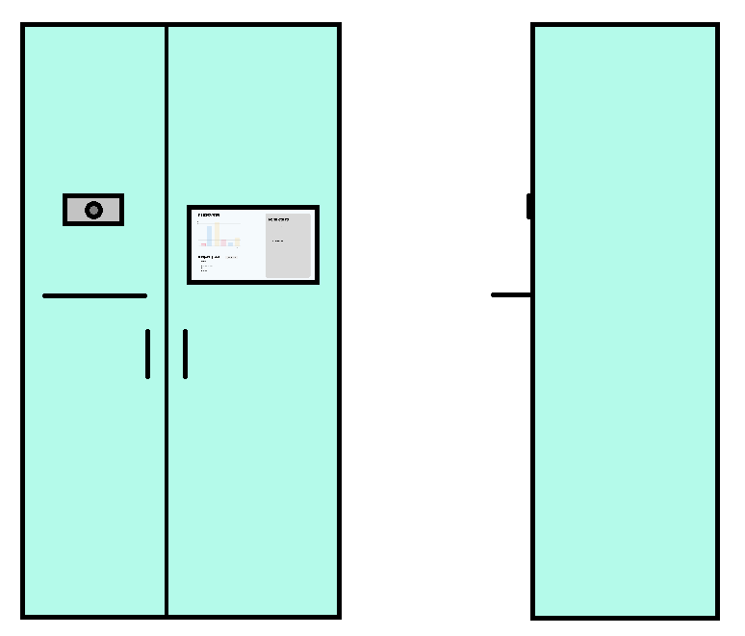
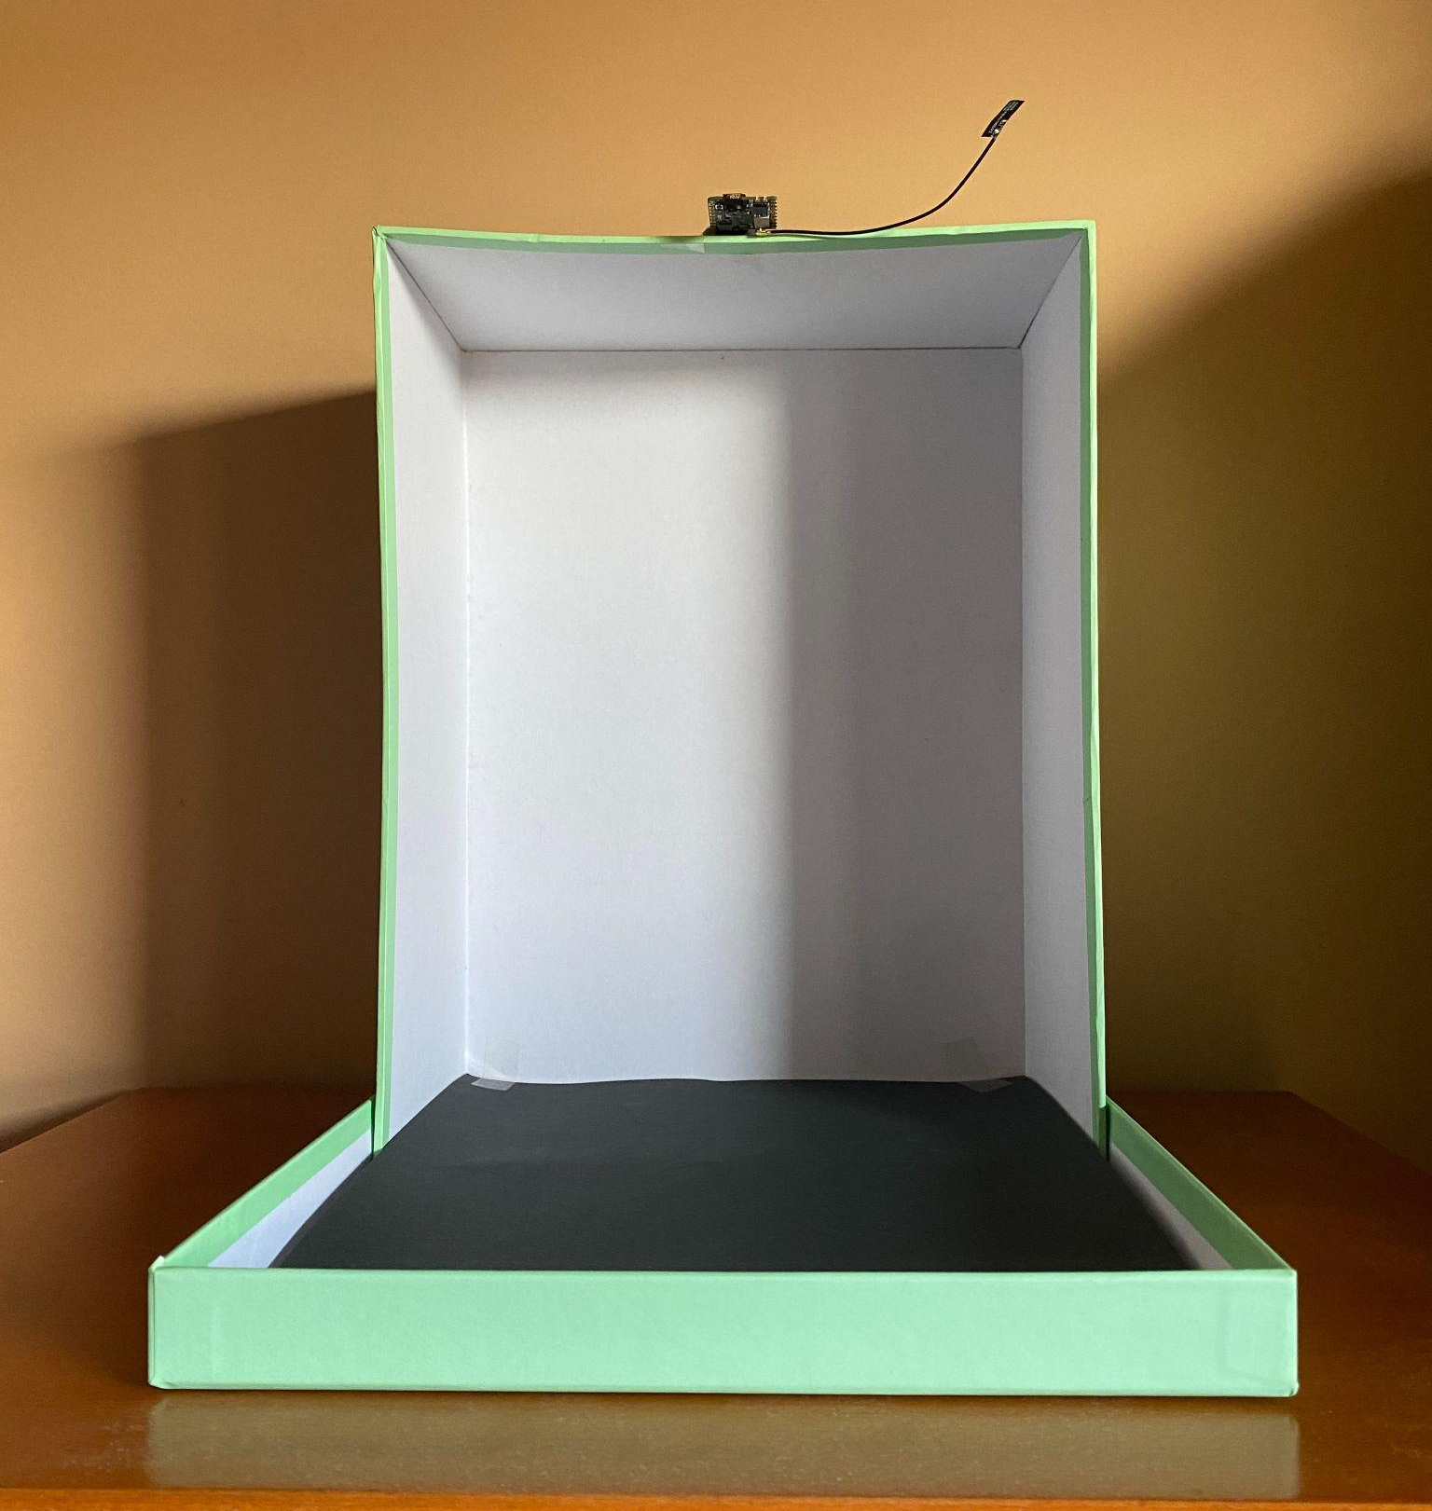
Setup Process
Notes:
JULIANA - In the first image we can see how our fridge is supposed to look like in a real world scenario and the second one is our prototype. Here we can see the camera, a little shelf where we put a product and a display with all of the informations

Slide 5
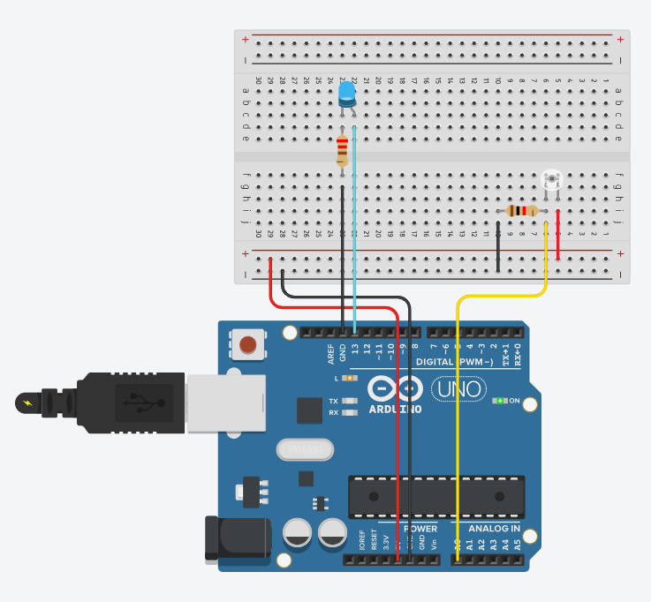
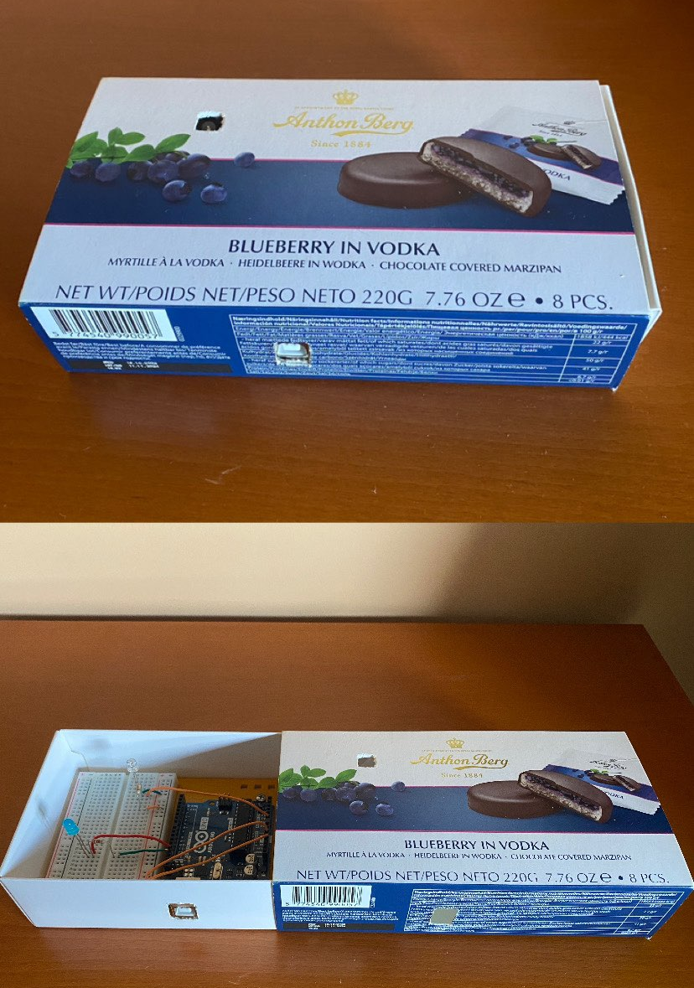
Setup Process
Notes:
INES - For the Arduino this is how it works. There’s a light sensor that, when covered by a product, the sensor detects it and this information is inserted in the database. There’s a blue light because it was easier to test like that. On the right we can see a shelf from the fridge with a little hole so the sensor can do its work.

Slide 6
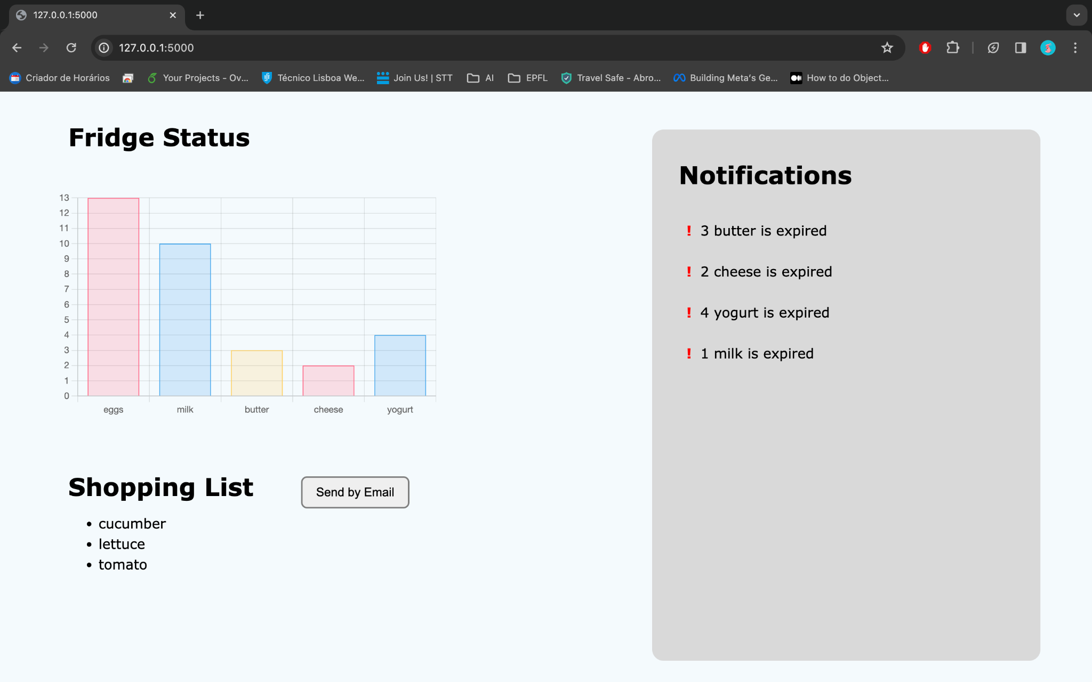
Setup Process
Notes:
ANA - Here we have the web app. It’s possible to see the products we have and respective quantities, a shopping list based on how many of each product we have with a button to send it by email and a notification center where we have alerts for products about to expire or already expired

Slide 7
Setup Process
Connect the camera to the system and run camera.py code in /data_process/camera/_model_ folder
Connect the Arduino to the system and run arduino.py code in /data_process folder
Run the web application app.py in /app folder and open http://127.0.0.1:5000 in the browser
Notes:
INES

Slide 8






Operation Process
Camera
Notes:
ANA
The user puts a product on the shelf to be scanned by the camera
The camera sends the captured image to the system where it is analyzed by a machine learning algorithm.

Slide 9
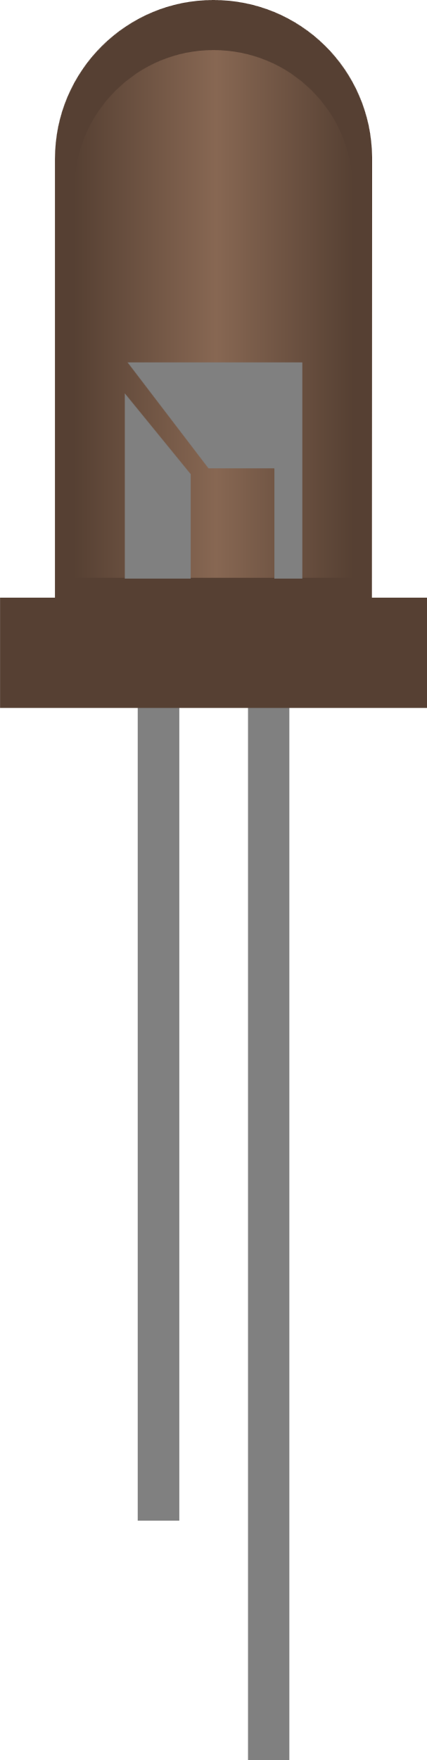
Operation Process
Quantity
1
Sensor
Water
Item
Notes:
ANA
The user places the product on a fridge shelf with a sensor inside that detects its presence. This information is then sent to the central system that will associate the sensor to the product. If the product is removed for a quick use, there is no need to scan it again: just take your water, drink, and put it again in the fridge

Slide 10
Operation Process
Quantity
3
2
1
Water
Item
Sensors
Notes:
ANA
If there is more than one product of the same type, there is no need of scan it multiple times. The fridge will assume that the most recent scanned product is the one to be considered

Slide 11
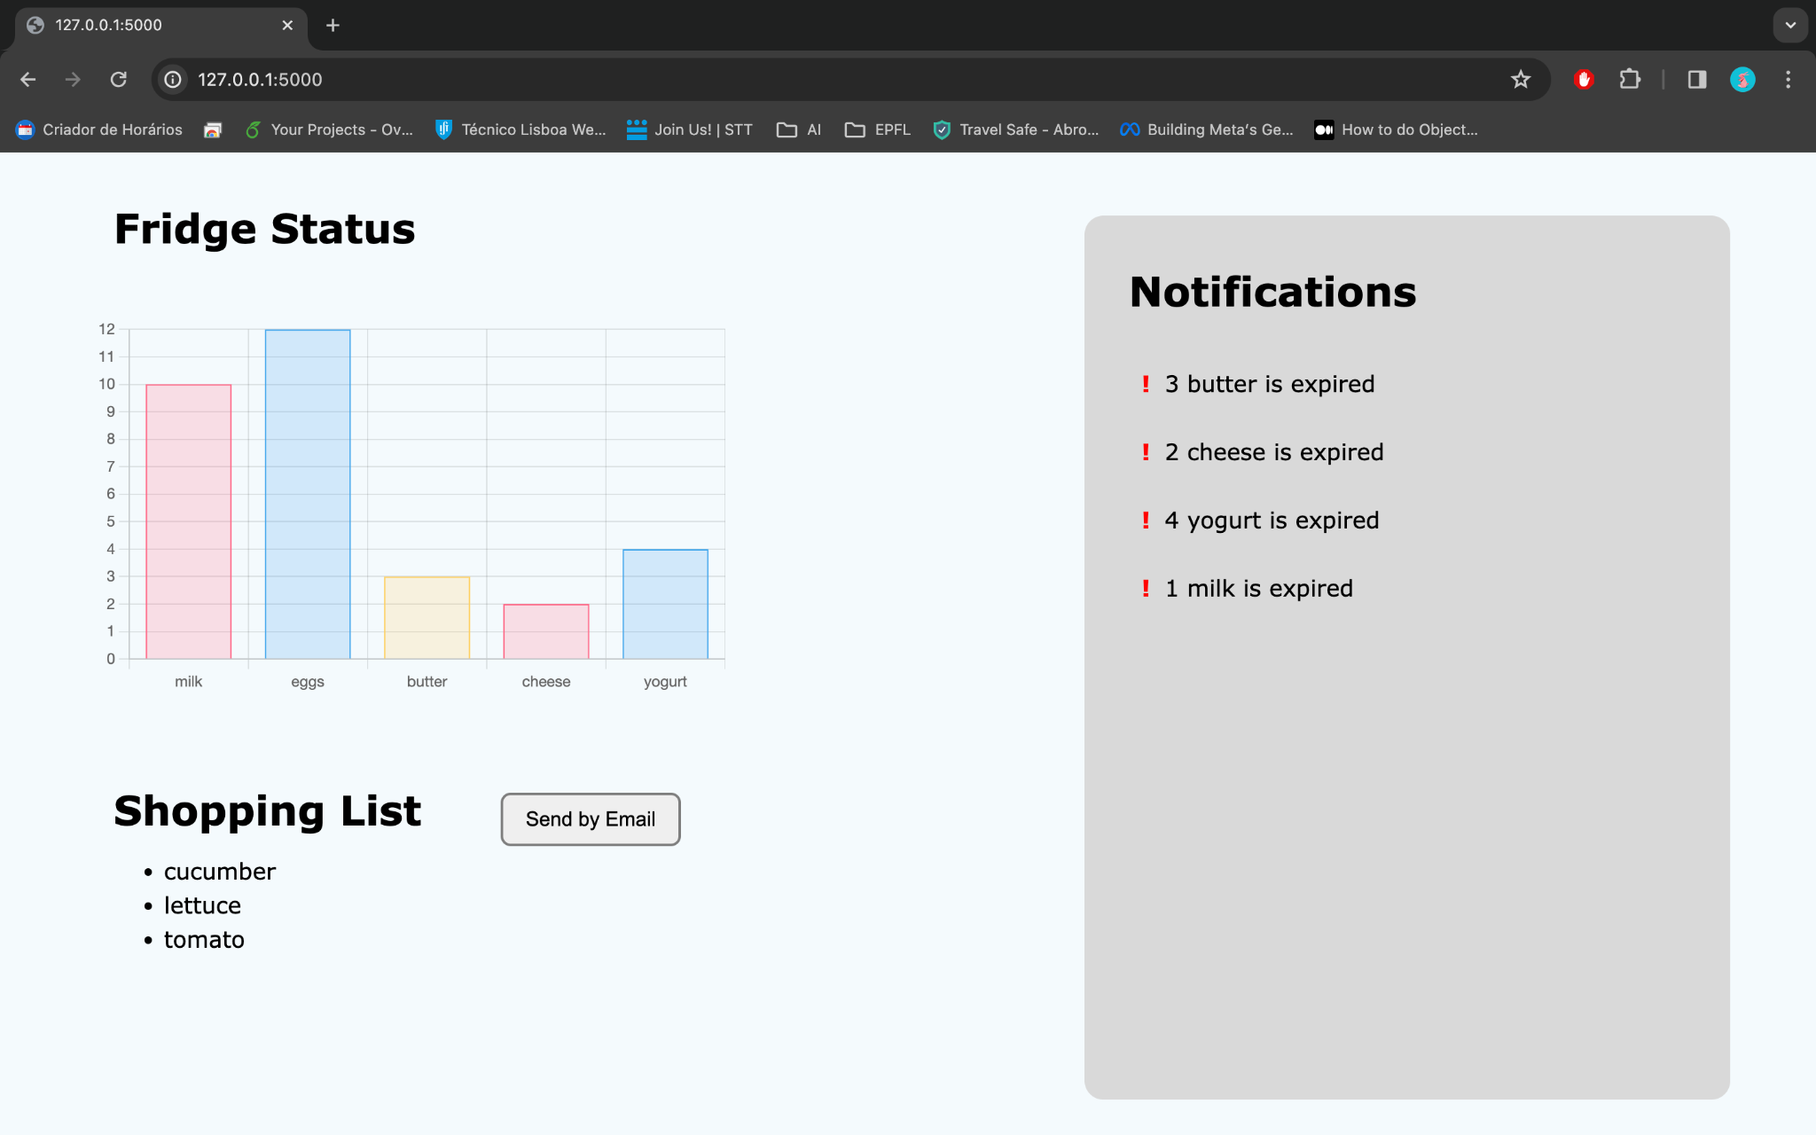
Operation Process
Notes:
JULIANA - And finally the process of sending the shopping list to the personal email:

Slide 12
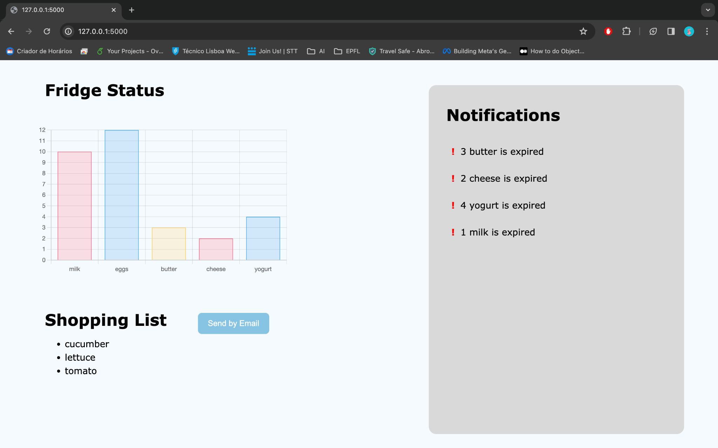
Operation Process
Notes:
JULIANA

Slide 13
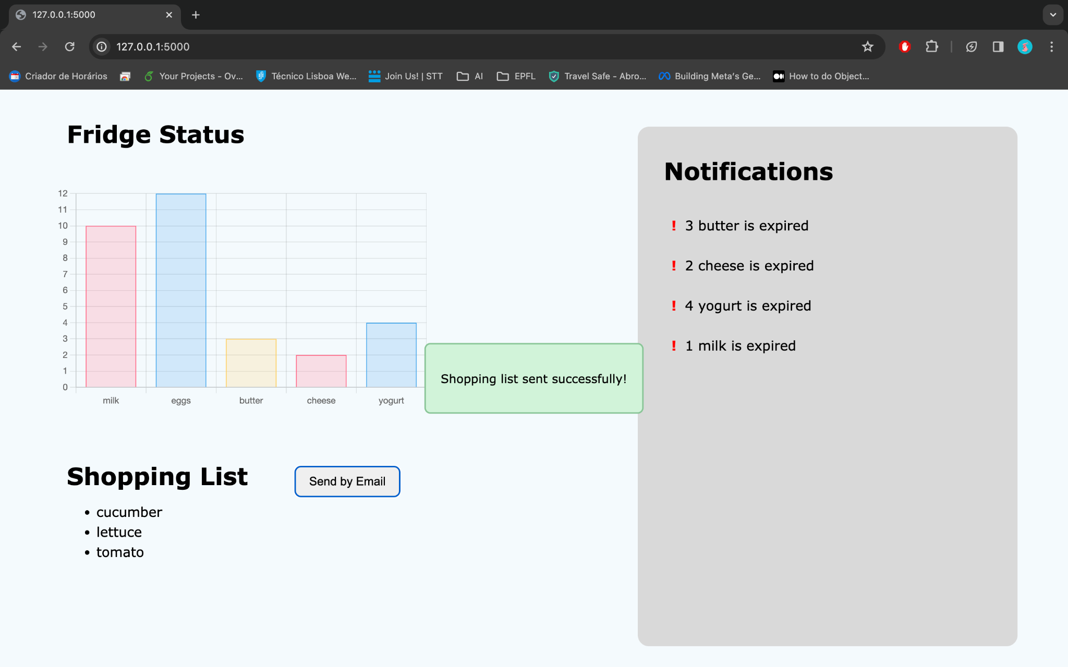
Operation Process
Notes:
JULIANA

Slide 14
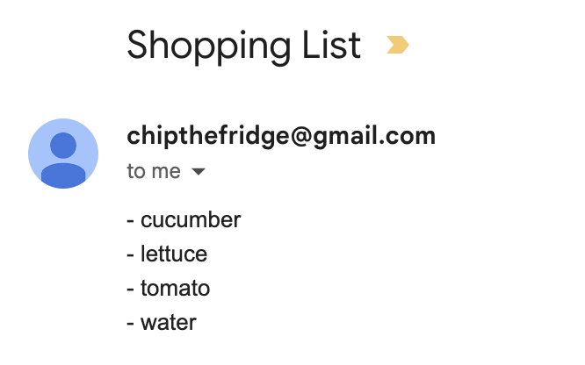
Operation Process
Notes:
JULIANA

Slide 15

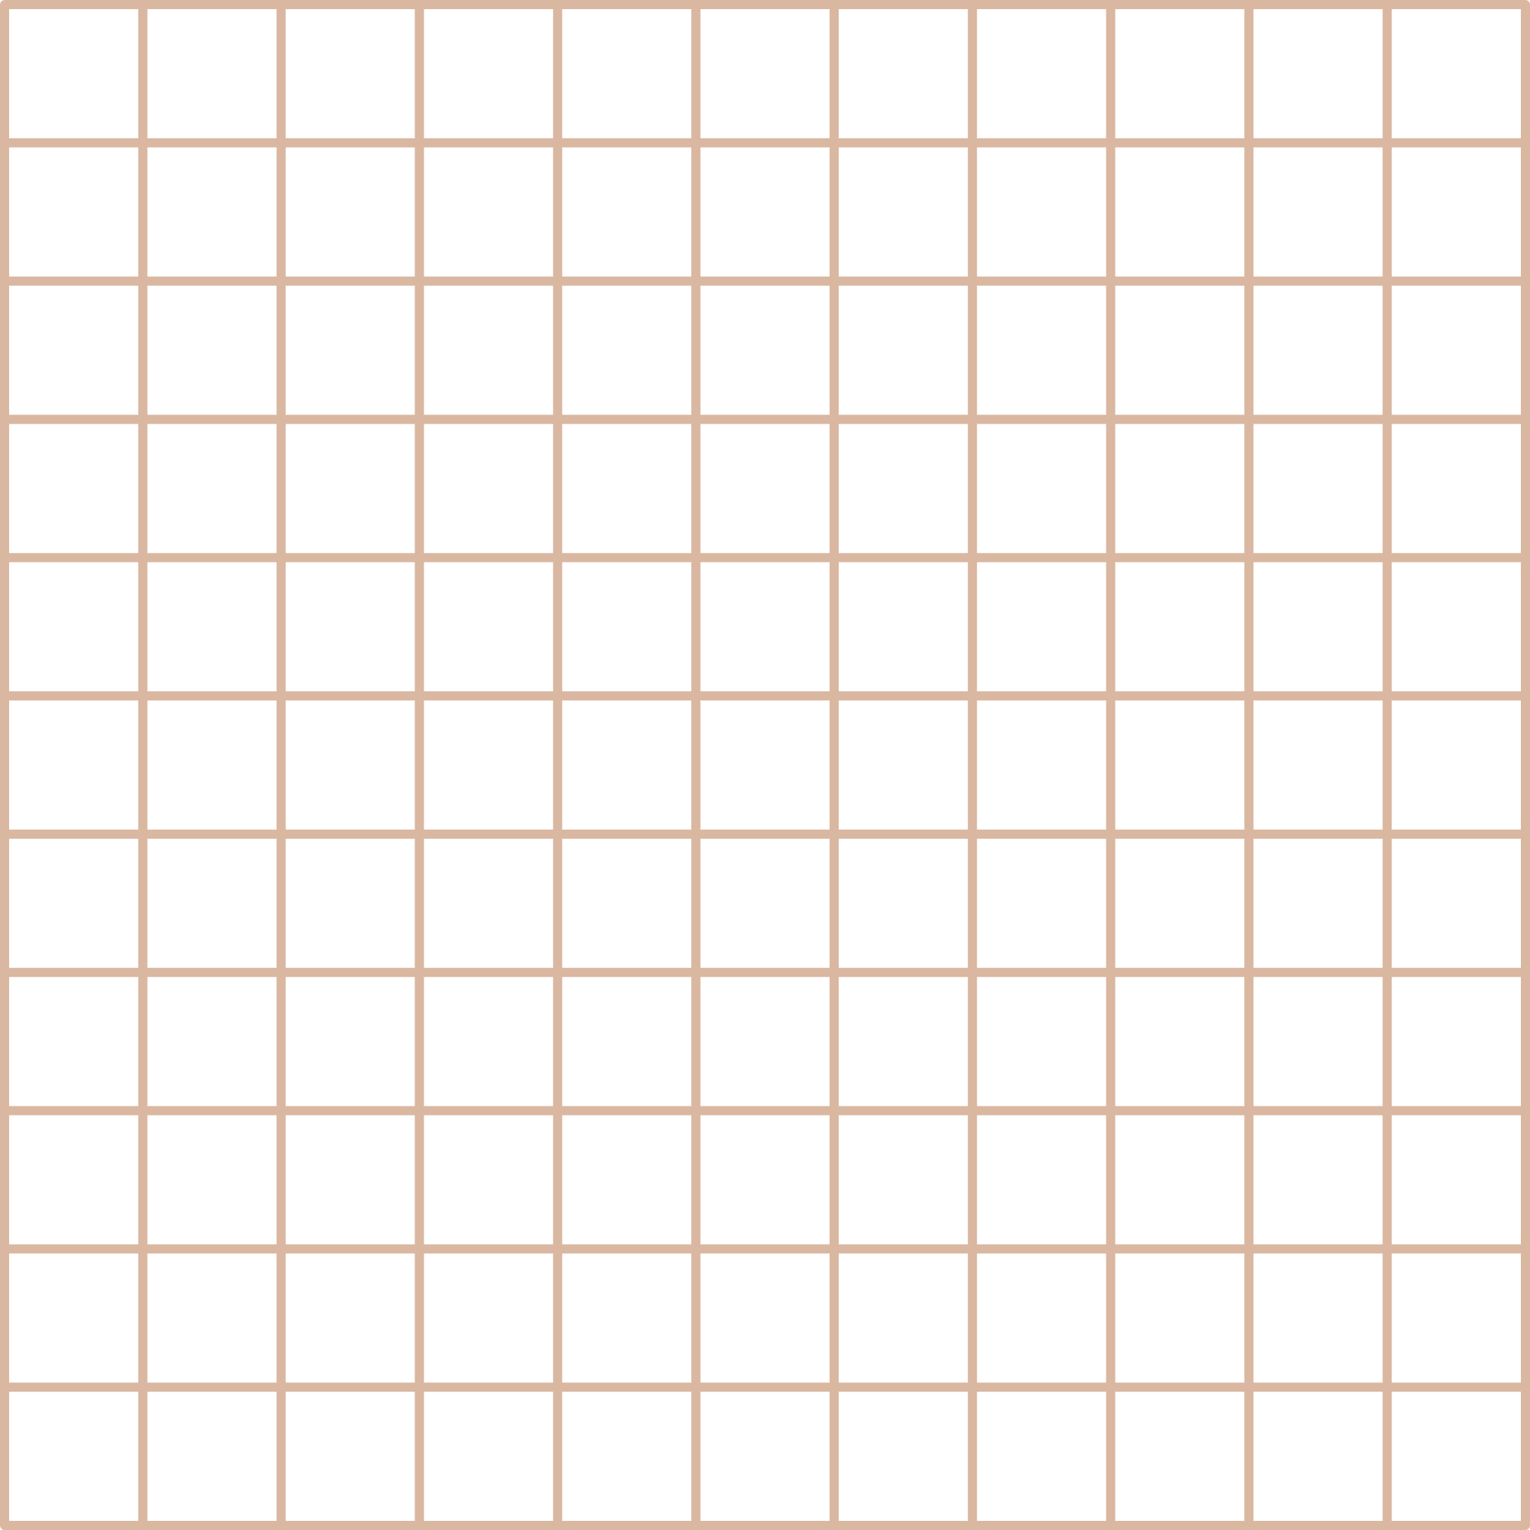


Demonstration

Slide 16



